Slide 1

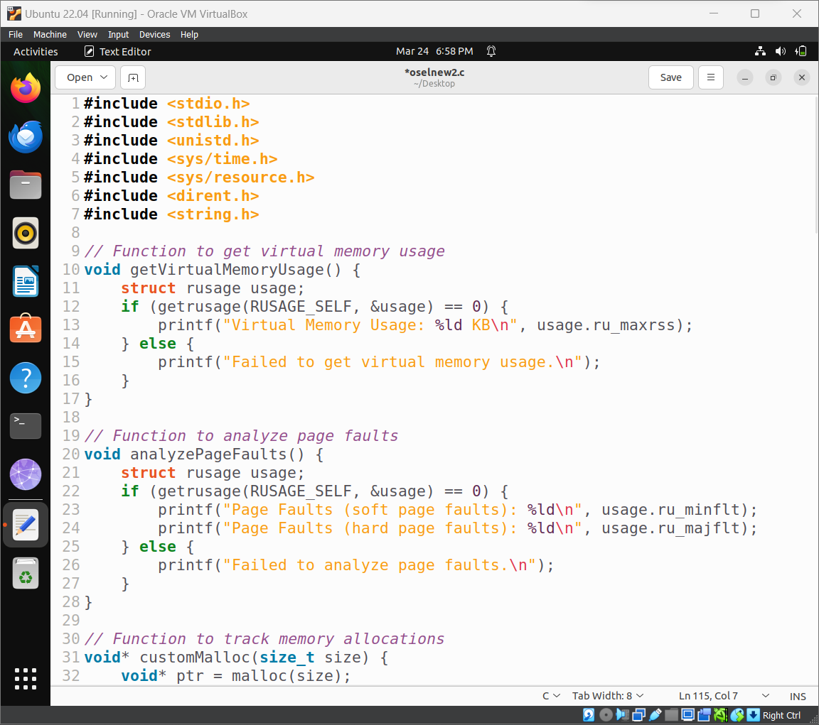
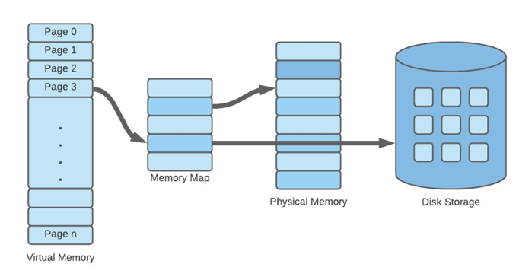
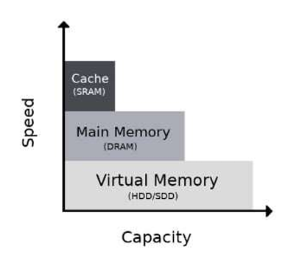
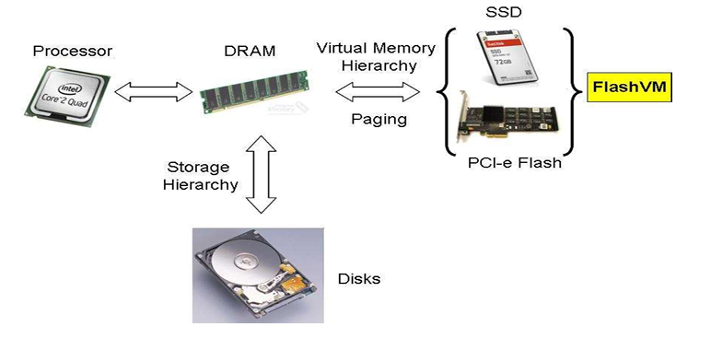
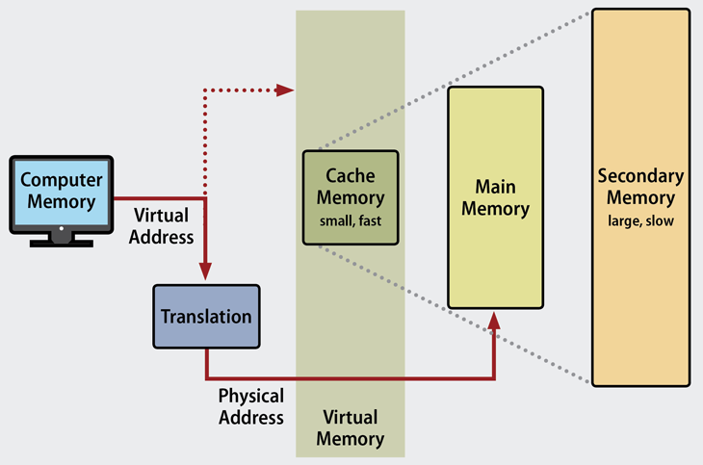
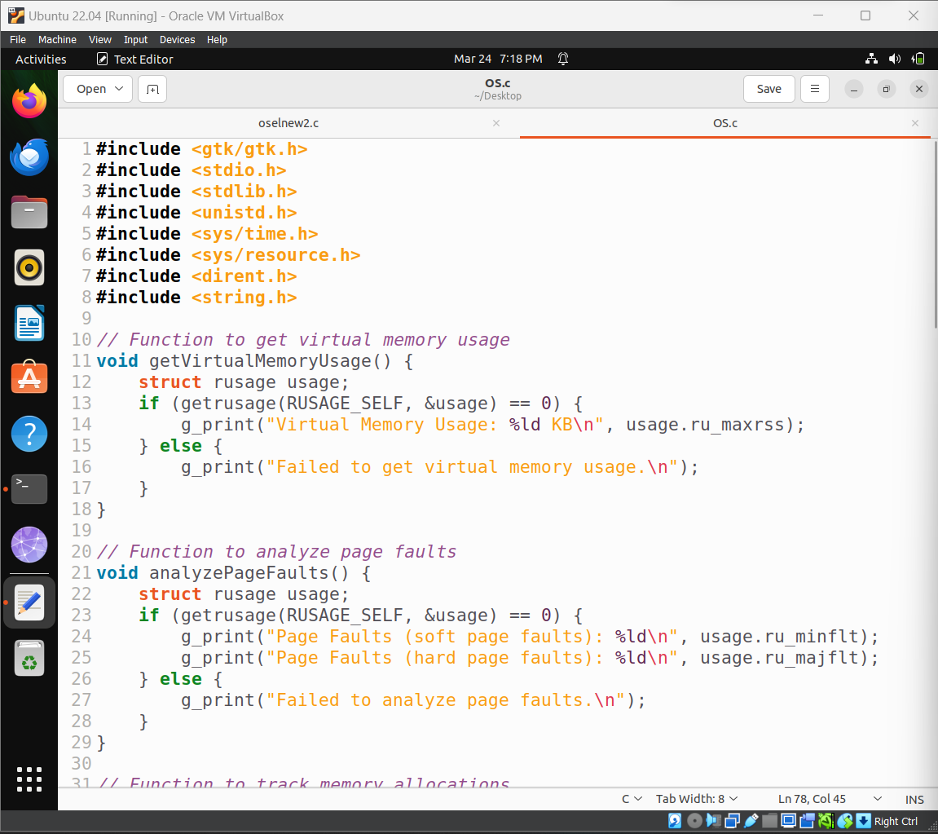
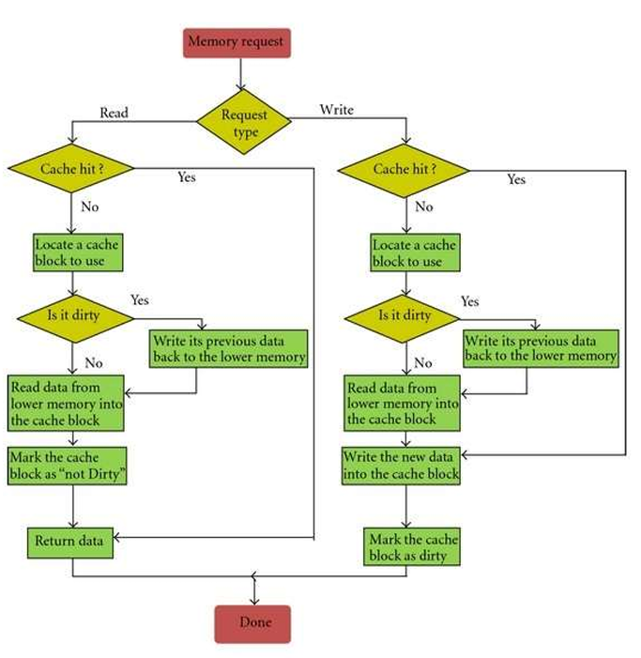
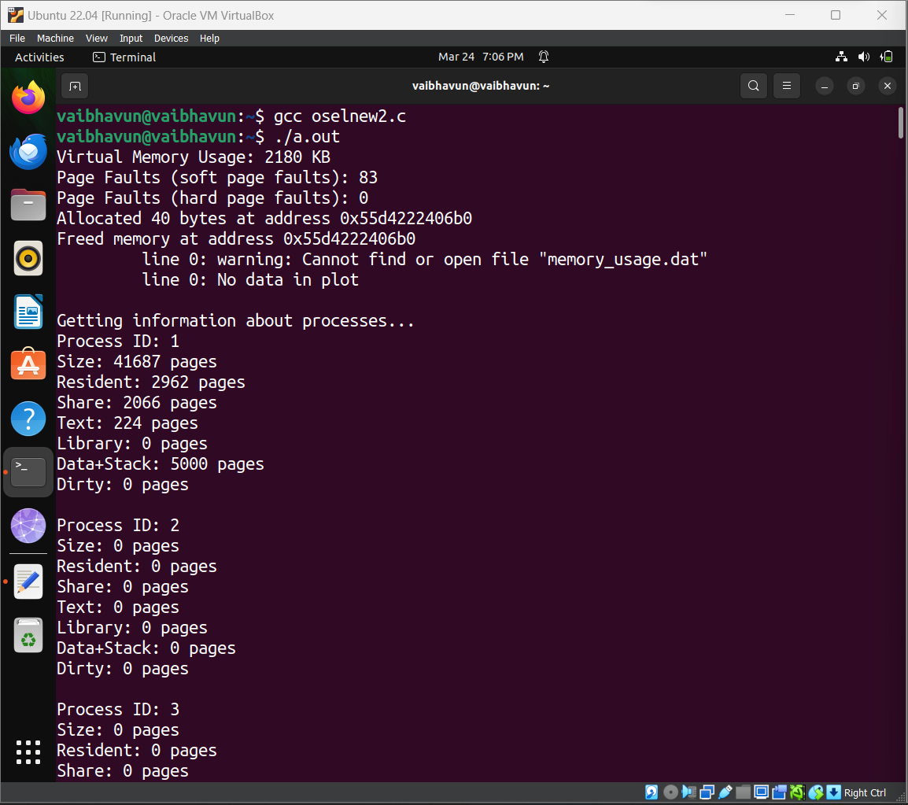
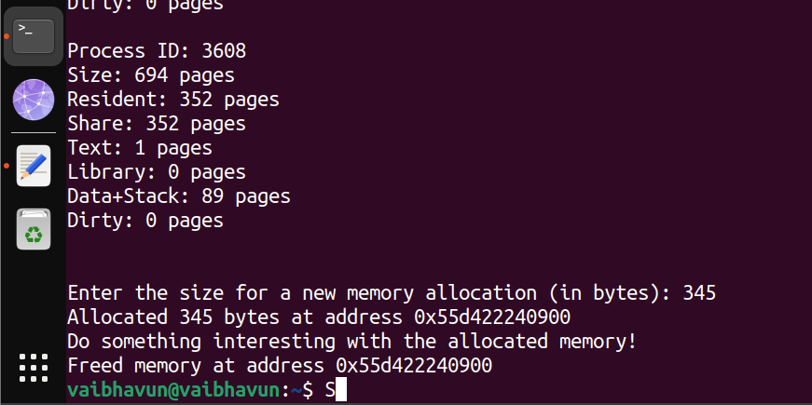
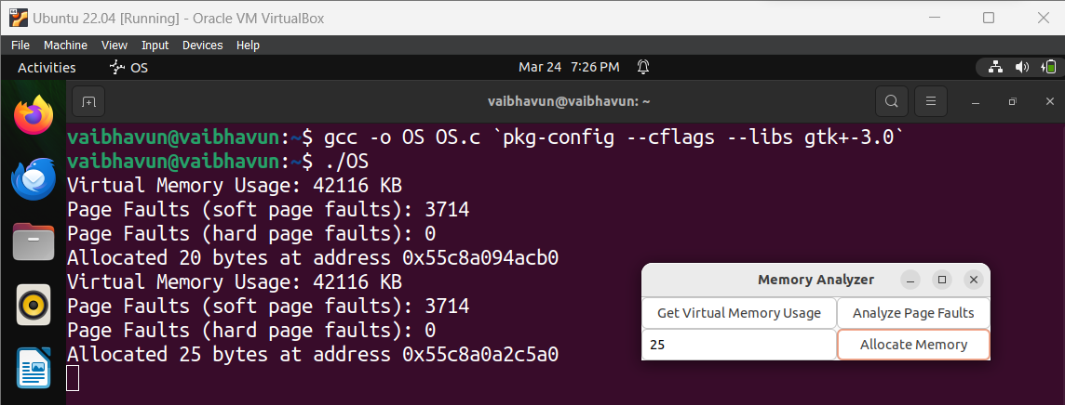
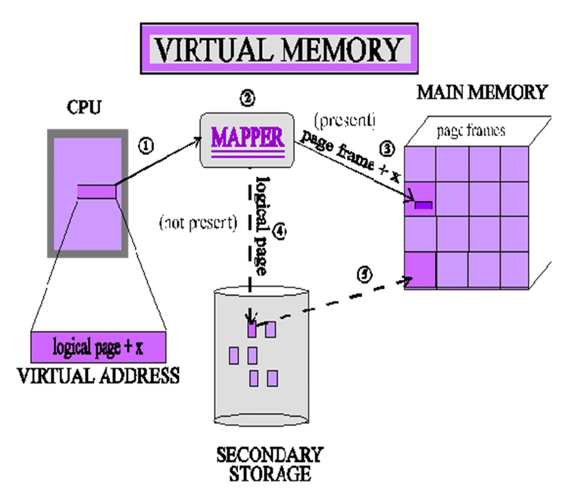
RV College of Engineering
Go, change the world
Operating Systems – Virtual Memory Analytics Suite
Name : Vaibhav U Navalagi [1RV22CS222]
Tejas Ganesh Hegde [1RV22CS219]
Introduction to Virtual Memory Analytics Suite :
In today's data-driven world, the ability to extract meaningful insights from vast amounts of information is paramount. Enter the Virtual Memory Analytics Suite (VMAS), a cutting-edge solution designed to transform the way organizations analyze and harness their data resources. Furthermore, VMAS prioritizes user-friendliness and accessibility, with an intuitive interface that empowers both data scientists and business users alike to derive actionable insights with ease.
C Program - 1
Object Detection with Software:
No Object is Detected(Green LED)
Object is Detected(Red LED)
Problem Statement :
Develop a comprehensive Virtual Memory Analytics Suite that employs advanced algorithms to analyze, optimize, and monitor virtual memory usage in computing systems, enhancing overall performance and resource efficiency.
C Program - 2
System Architecture :
This architecture operates on the principle of virtualization, where the physical memory space is abstracted into smaller, more manageable units known as pages or blocks. Through intelligent memory mapping techniques, VMSA dynamically manages the allocation and retrieval of data, optimizing performance while minimizing latency.
Methodology – Flowchart :
Output - 1
Output - 2
Tools and APIs used :
C programming language for system-level programming.
System calls such as getrusage for gathering memory usage statistics.
#include<sys/resources.h> header file to get all the recently used up processes by the system through kernel.
Visualization libraries such as matplotlib or gnuplot for generating graphical representations of data.
Applications :
Performance Monitoring and Optimization
Capacity Planning and Resource Allocation
Troubleshooting and Debugging
Guide Information:
Dr. Jyoti Shetty Assistant Professor

